Slide 1
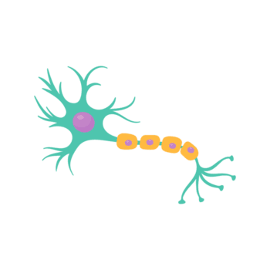
CAN LLMS PREDICT HUMAN NEURAL ACTIVATION?
Rădulescu Horia Filip - 334
Zidăroiu Maria - 334

Slide 2
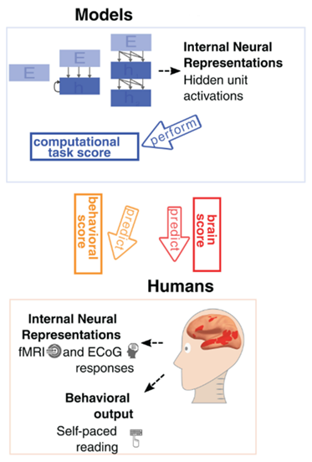
Introduction
Recent advances in large language models (LLMs) enable not only text generation but also the prediction of human brain activity.
Our project aims to test the extent to which LLMs can predict human neural activation and to identify the models and strategies that best align with brain language processing.
Understanding how LLMs relate to human brain activity can provide insights into both the mechanisms of language processing in the brain and the development of more cognitively aligned artificial intelligence.

Slide 3
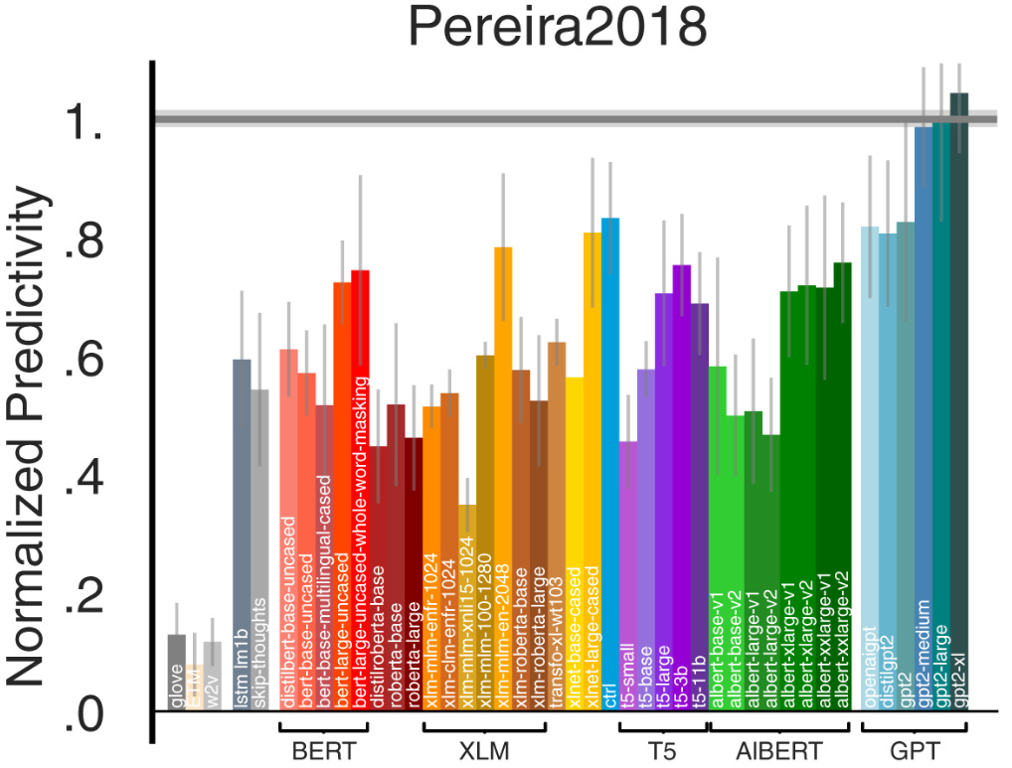
Previous Work
Transformer models like GPT-2 and BERT can predict neural responses to sentences (Schrimpf et al., 2021).
LLM embeddings also capture how well humans understand stories (Toneva et al., 2022).
Larger models tend to align better with brain activity (Hewitt et al., 2023).
Model hierarchies reflect the brain’s language processing hierarchy (Schrimpf et al., 2024).

Slide 4
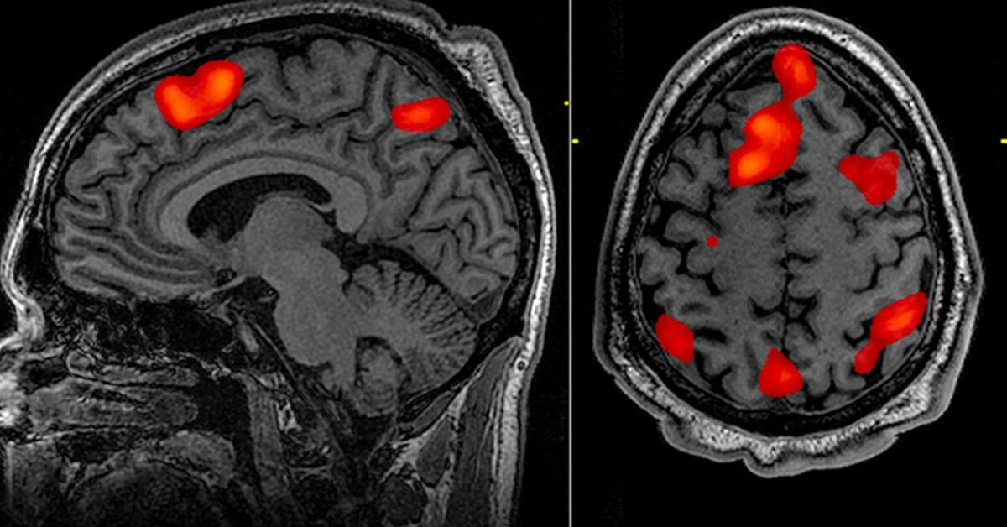
Data
Dataset: Pereira2018 fMRI dataset.
Subjects: Neural responses from multiple human participants listening to sentences and stories.
Stimuli: Visually presented passages, sentence by sentence
Data type: Textual stimuli (input to LLMs).
Brain activation measurements (fMRI) for each stimulus.
Purpose: Compare GPT-2 activations with human neural responses to evaluate alignment.

Slide 5
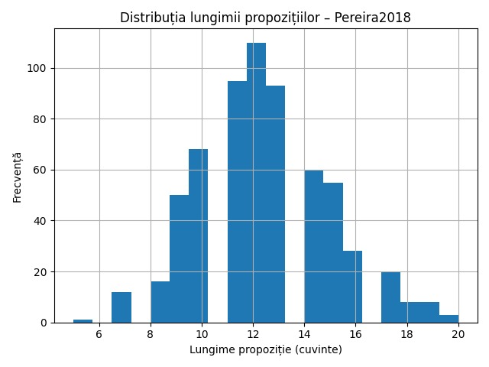
Exploratory Data Analysis
Sentence Length Distribution – Pereira2018
Most sentences:
10–14 words (peak at 11–13 words) → medium length, suitable for LLMs.
Some short sentences (6–8 words) → likely introductory.
Few long sentences (18–20 words) → outliers.
Importance:
- Neural activation depends on sentence length.
- Helps interpret model-to-brain alignment.

Slide 6
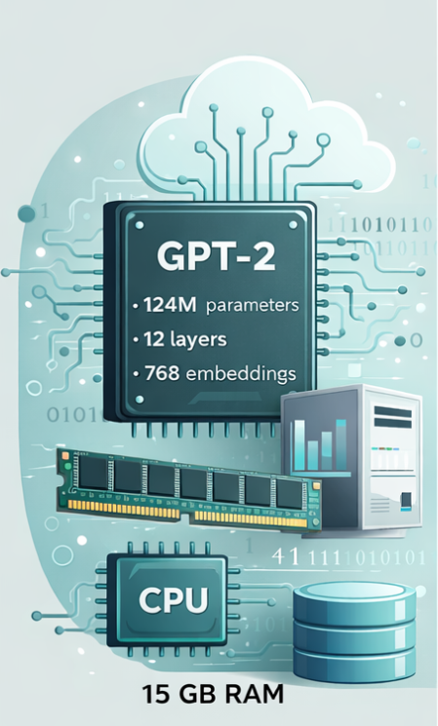
Model and Computational Requirements
Model: GPT-2 (~124M parameters, 12 layers, 768 embeddings).
Library: neural-nlp.
Hardware: CPU only, Intel i7, 15 GB RAM.
Runtime: Pereira2018: 4 min; Larger models not used due to memory/time constraints.

Slide 7
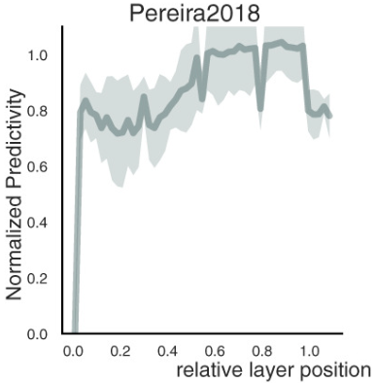
Model Evaluation and Comparison
Brain-Score metrics: Quantify how well model activations predict neural responses.
Centered Kernel Alignment (CKA): Measures similarity between model representations and neural activation patterns across layers.
Pearson correlation: Assesses linear correlation between predicted and observed neural responses.
Benchmark comparisons: Evaluate models (e.g., GPT-2) on datasets like Pereira2018 to find layers and architectures that best align with brain activity.
Layer-wise brain score for GPT-2 on the Pereira2018 dataset.

Slide 8
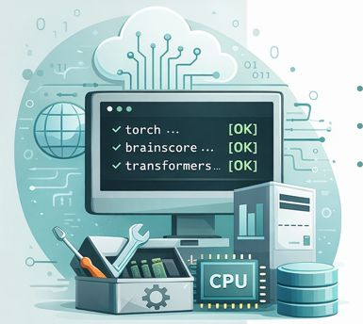
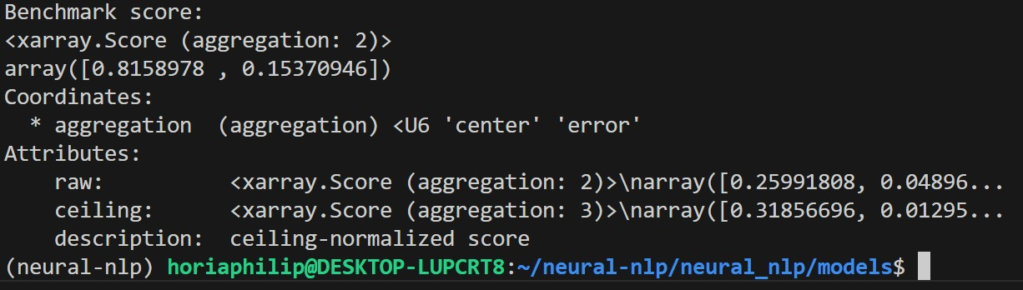
Environment Setup and Validation
Setup: Recreated legacy environment for neural-nlp benchmarks (2018–2020 codebase).
Tools: Conda environment with Python 3.8, older PyTorch, Brain-Score, and manual dependency adjustments.
Validation:
GPT-2 activation extraction
CKA computations
Pereira2018 benchmark
Benchmark result: 0.8159 → confirms full reproducibility and functionality.

Slide 9
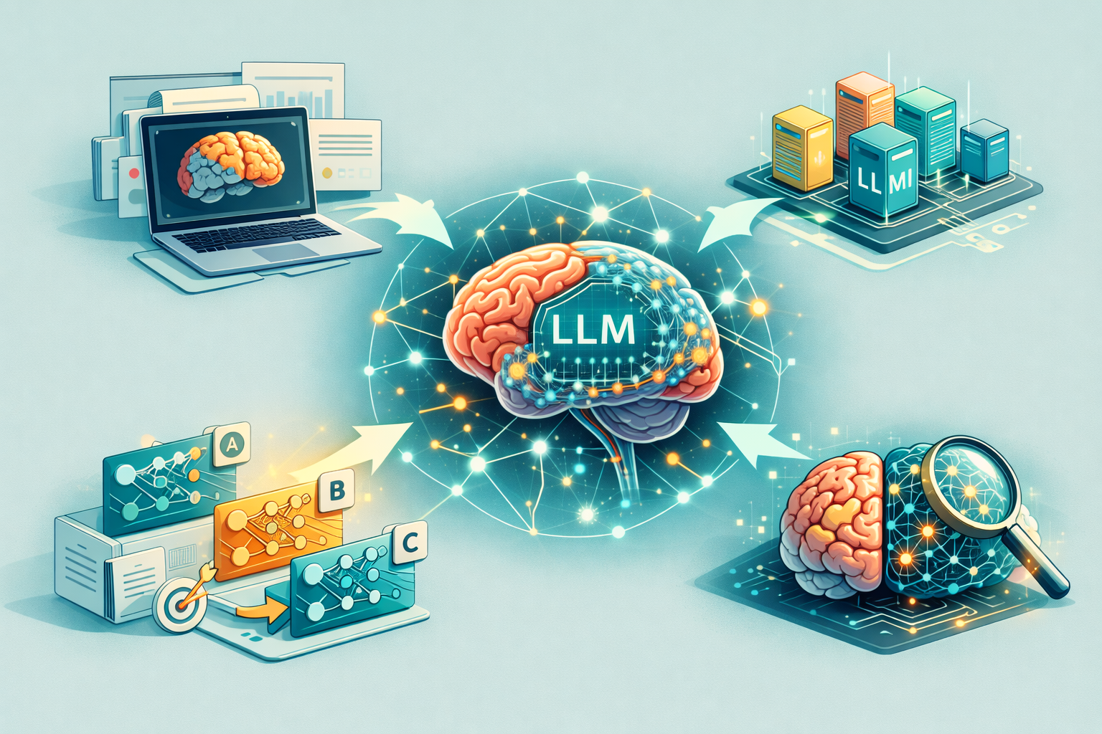
Conclusions and Future Work
Conclusions:
Successfully set up and validated the neural-nlp environment.
GPT-2 activations align with Pereira2018 fMRI responses, confirming reproducibility.
Future Work:
Extend experiments to additional LLMs and neuroimaging datasets.
Compare architectures, training objectives, and layer alignment with brain activity.
Gain broader insights into how LLMs capture human language processing.

